Slide 1
Paper Review (I/O)
Advances in Operating System Design
Presented by:
Atishay Jain 20CS30008
Gaurav Malakar 20CS10029
Roopak Priydarshi 20CS30042
Siripuram Bhanu Teja 20CS10059

Slide 2
Efficient and Safe I/O Operations For Intermittent Systems
Included in the Proceedings of 2023 EuroSys

Slide 3
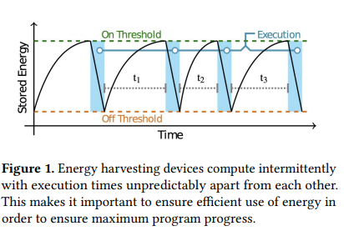

With the Predictions of more than a trillion IOT things by 2035,the concerns for cost and maintenance have been raised.
These devices doesn’t rely on a continuous and reliable power supply,instead they harvest energy from environment and compute only when enough power is buffered up ,they compute intermittently.
Power failures can occur at any time during the execution, so they have to restart the execution from the saved state which often leads to several problems.
This paper aims to address those challenges
Intermittent Computing

Slide 4
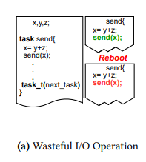
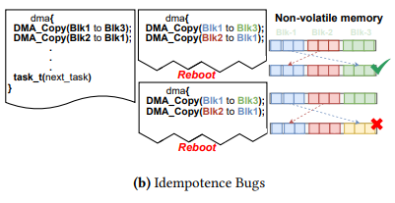
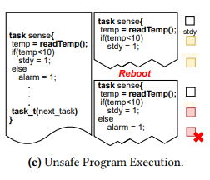
In task based intermittent systems programs are divided into tasks,which have all or nothing semantics.So in case of power failure it will restart the task.
This leads to following following challenges
Wasteful Repetitive I/O Operations
Idempotence Bugs.
Unsafe Program Execution.
Challenges Faced by Intermittent Systems

Slide 5
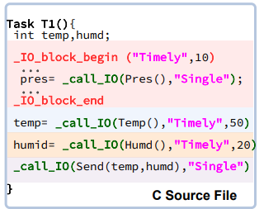
Ease IO Overview
The current intermittent runtimes lack programming language support to capture re-execution semantics ,leading to repeated I/O.
Ease I/O provides programming language semantics that allows programmer to specify the I/O re-execution semantics and a run time that uses this information avoiding repetitive I/O and memory inconsistencies.
Ease I/O introduces 3 keywords to specify re-execution semantics
Single: This conveys the runtime that the I/O operation should only execute only once .
Timely: This tells the runtime that the given I/O operation has timeliness constraints .In case the I/O operation succeeded previously and if the result is valid the I/O operation is need not be executed again.
Always: This directs the runtime that the given I/O operation should be always re-executed upon power failure.

Slide 6
Ease I/O exposes programming interface for programmers to use the semantics mentioned before
__call_IO :
This interface lets users to specify the re-execution semantics for the I/O operation .
__IO_block_begin/_IO_block_end :
These interfaces define the the boundaries of atomic execution for multiple I/O functions.
__DMA_copy:
This handles the block data copy via DMA peripheral ,dynamically adjusting the re-execution semantics based on memory types to prevent inconsistency.

Slide 7
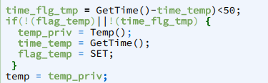
Implementation details of Re-execution Semantics
Single semantics are implemented using a dedicated boolean flag that keeps track of the completion of I/O operation.And to restore the correct return value of the function incase if it fails to get re-executed (i.e it completed execution in previous cycle) it avoids data inconsistencies by maintaining a non volatile copy of the return value.
Timely semantics are implemented by maintaining two non volatile variables one storing the timestamp of last execution and other flag tracking the I/O completion.
Always semantics relies on task-based models and doesn’t need new logic to implement re-execution semantics.

Slide 8
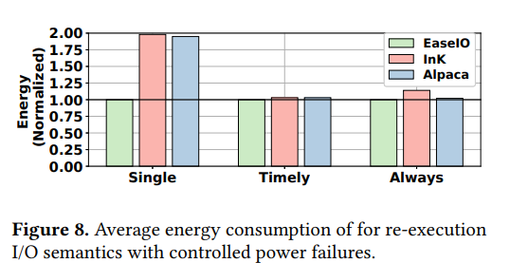
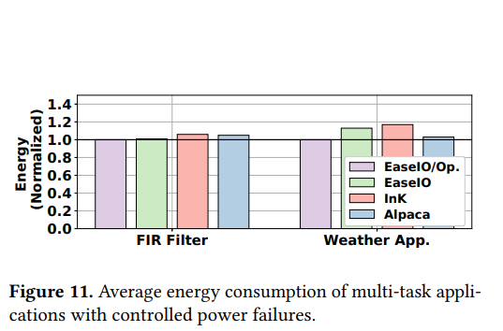
Evaluation
1.Energy Consumption: Energy consumed to finish the single execution of target application.

Slide 9
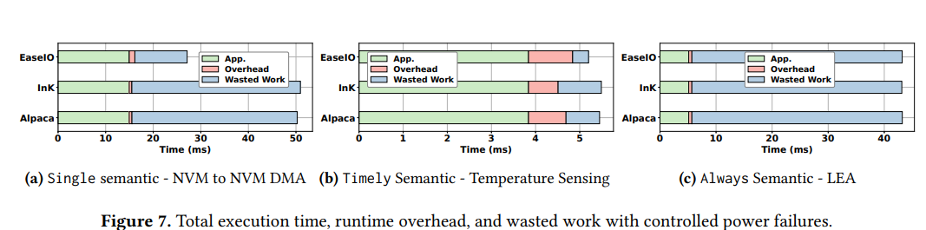
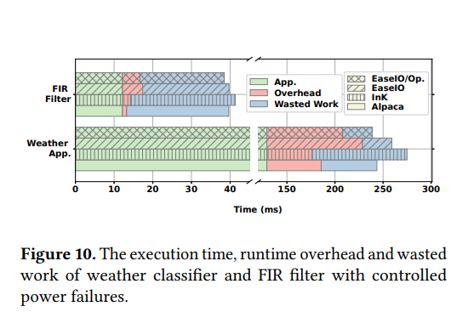
2.Wasted Work :

Slide 10
Asynchronous I/O Stack:
A Low-latency Kernel I/O Stack for
Ultra-Low Latency SSDs
Included in the Proceedings of the 2019 USENIX Annual Technical Conference.
(USENIX ATC '19)

Slide 11
Asynchronous I/O Stack:
A Low-latency Kernel I/O Stack for
Ultra-Low Latency SSDs
Included in the Proceedings of the 2019 USENIX Annual Technical Conference.
(USENIX ATC '19)

Slide 12
How an I/O request is handled
Layered Process: An I/O request traverses multiple layers, including the file system, block layer, and device driver.
Handling of a single I/O request needs completion of multiple kernel level operations before that.
Synchronous Operations: Key operations like page allocation and DMA mapping occur in a synchronous manner before the actual I/O command.
The device driver handles the final submission and completion of I/O commands.
“ For traditional storage devices, the time spent on kernel operations is relatively negligible compared to the time consumed by the device itself “

Slide 13
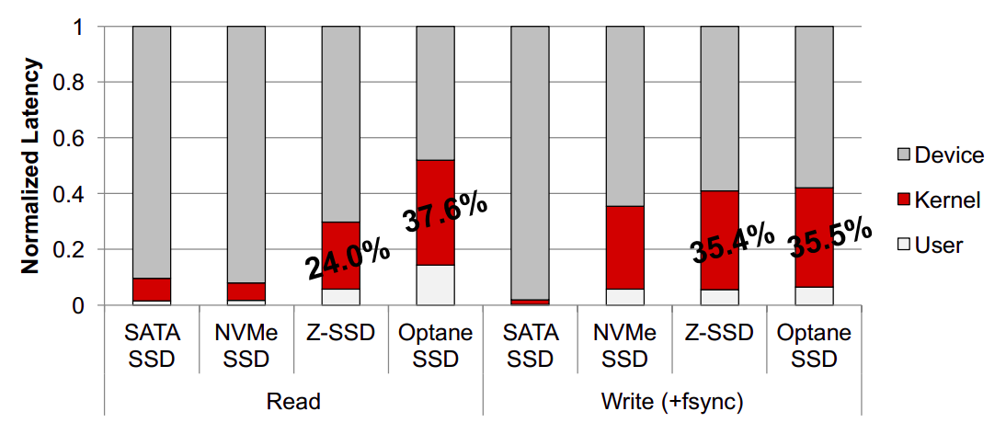
Kernel I/O Stack Overhead

Slide 14
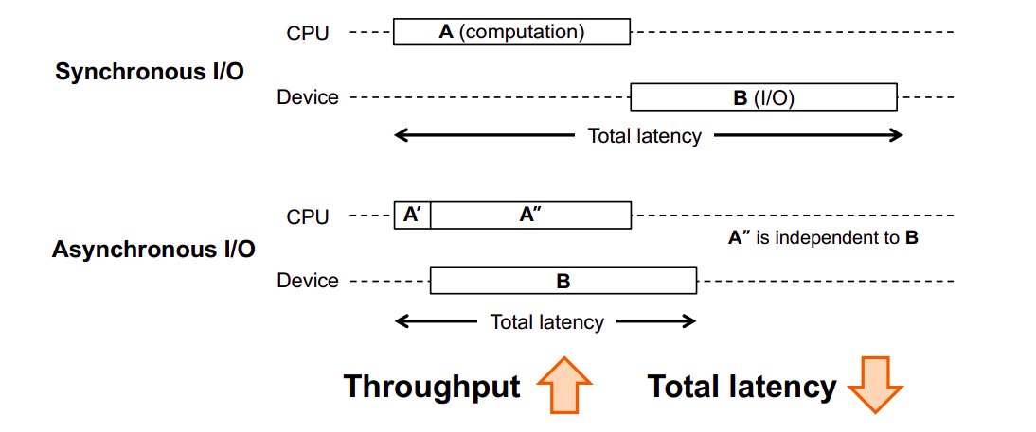
Asynchronous I/O Stack
Kernel operations during I/O are largely device-independent and can be parallelized.

Slide 15
Traditional Read Path
Buffered Read System Calls
Entry through read() and pread() calls.
Leads to Virtual File System (VFS) function which in turn leads to cache layer
Page Cache Process
Cache miss triggers allocation and indexing of a new page in the page cache.
DMA Mapping
Creation of Direct Memory Access (DMA) mapping for the allocated pages.
“The synchronous nature of these operations leads to inefficiencies”

Slide 16
Asynchronous Read Path
Shift to Asynchronous Operations
Overlaps CPU and device I/O tasks to reduce end-to-end I/O latency.
Efficient Page Management
Asynchronous page allocation and DMA mapping performed parallel to device I/O.
Lazy DMA Unmapping
Delays DMA unmapping to idle times, reducing critical path duration.
Lightweight Block I/O Layer
Customized LBIO layer for NVMe SSDs minimizes I/O request submission delay.

Slide 17
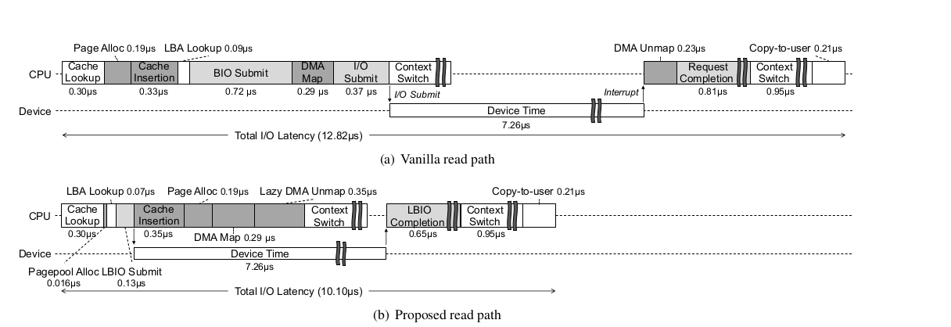
Comparison of Read Paths
21% latency reduction

Slide 18
Linux Block I/O Layer
Multi-Queue Architecture: Designed for NVMe SSDs, scales well with multi-core CPUs
Core Functionalities: Handles block I/O submission/completion, request merging/reordering, I/O scheduling, and command tagging.
I/O Scheduling and Merging: Supports various I/O schedulers; default often set to 'noop' for fast storage devices.
Challenges with Ultra-Low Latency SSDs: Time spent in block layer becomes significant part of total I/O latency. ( About 15% of the device time )

Slide 19
Light-weight Block I/O Layer
Simplified Operations
Focuses on essential functions: I/O submission/completion
Eliminates complex operations like bio-to-request transformation
Efficient Data Structure
Utilizes a single lbio memory object for each block I/O request
Features a global lbio array, with dedicated rows for each core and NVMe queue pair, so locks are no longer needed
Direct Command Dispatch
Enables threads to directly dispatch NVMe I/O commands, bypassing I/O merging and scheduling.

Slide 20
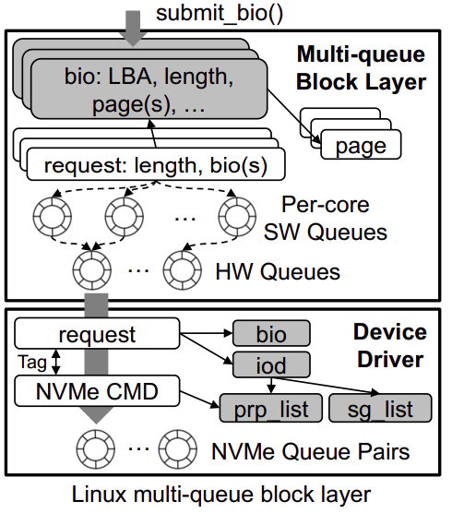
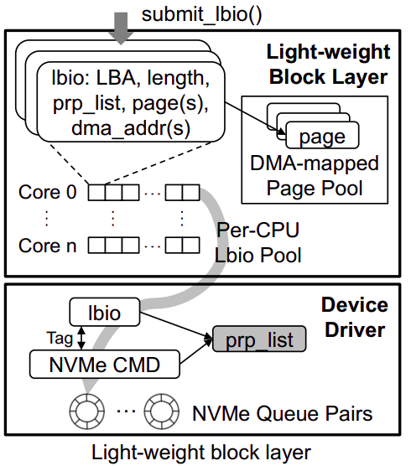
Block I/O Layers Compared

Slide 21
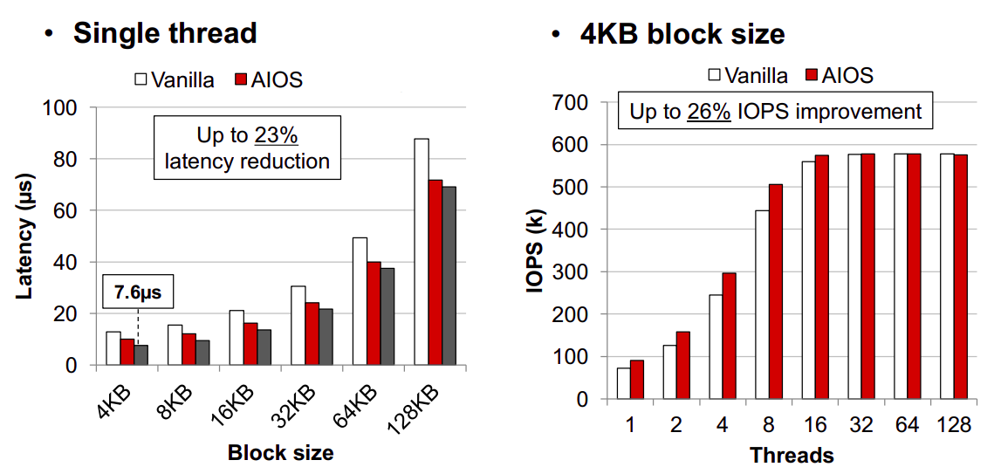
Read Performance Results

Slide 22
GIFT: A Coupon Based Throttle-and-Reward Mechanism for Fair and Efficient I/O Bandwidth Management on Parallel Storage Systems
Included in the Proceedings of the 18th USENIX Conference on File and Storage Technologies (FAST ’20)

Slide 23
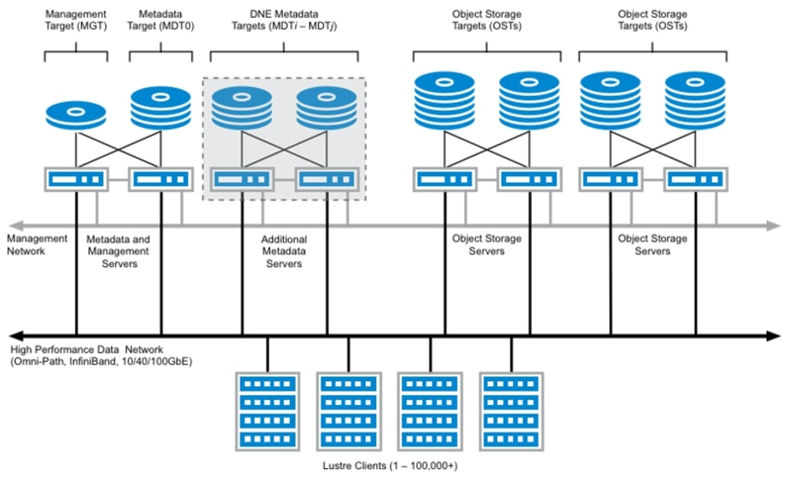
High Performance Computing
Data Intensive parallel applications switch between compute and I/O phases.
The architecture of a typical parallel storage system of a high performance computing system is given in the diagram.

Slide 24
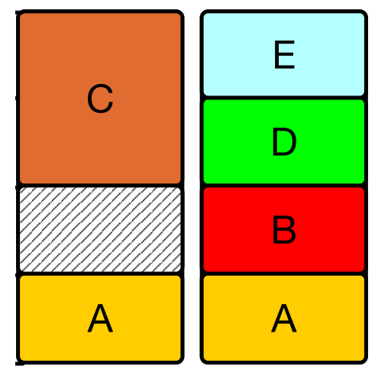
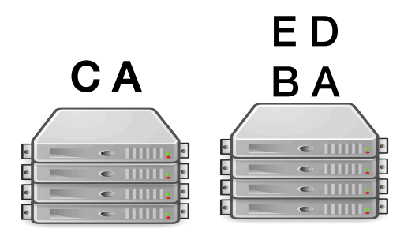
I/O in parallel applications
Parallel applications can cause unmanaged and unpredictable I/O interference! One application performs I/O concurrently to multiple OSTs:
OST 1 OST 2
Inefficient I/O bandwidth utilization
Object Storage Targets (OSTs)

Slide 25
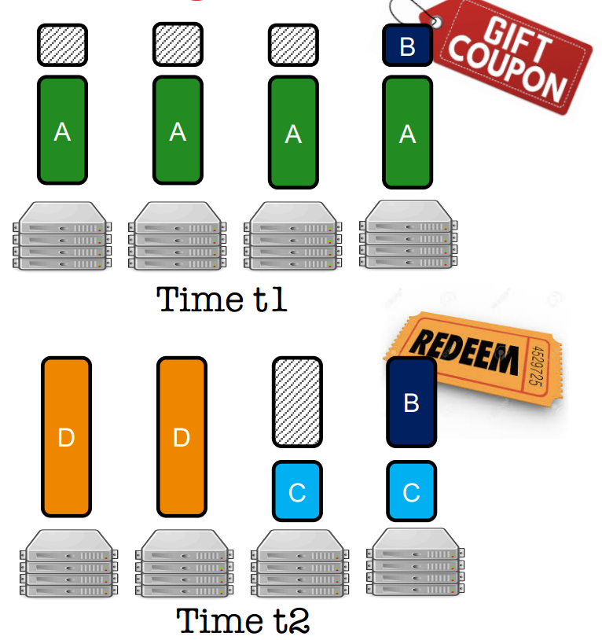
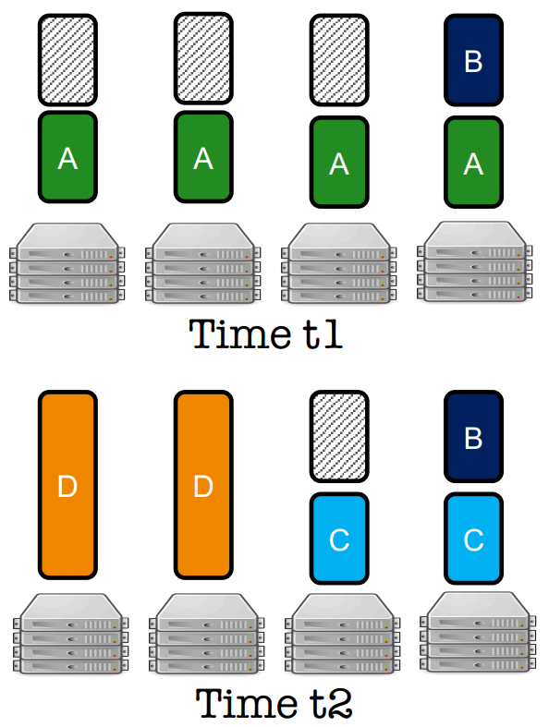
Working of GIFT
Traditional
GIFT

Slide 26
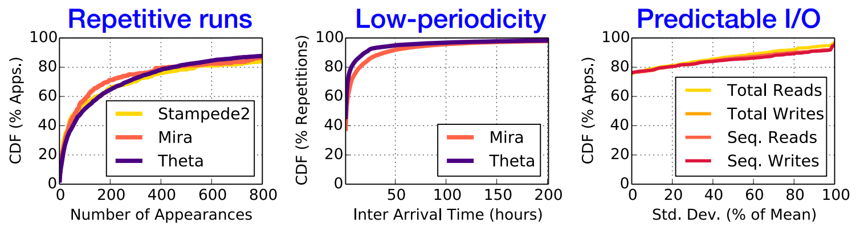
Why does it work?
HPC applications run repeatedly, are frequent, and exhibit similar I/O behavior across different runs:

Slide 27
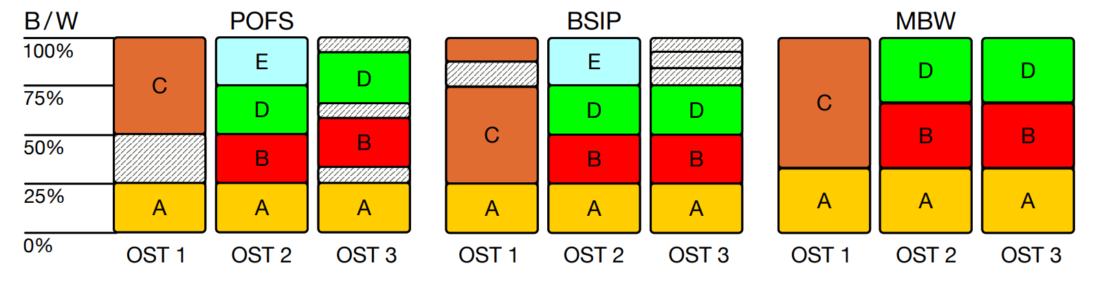
GIFT challenges
Parallel applications suffer from non-synchronous I/O progress leading to bandwidth wastage.
Need for synchronous I/O progress in parallel applications poses new challenges in maintaining efficiency and fairness in I/O bandwidth allocation. Some bandwidth allocation policies:
Basic Synchronous I/O progress
Minimum Bandwidth Wastage
Per-OST Fair share
Fair
Not Synchronous
B/W waste
Fair
Synchronous
B/W waste
Not Fair
Synchronous
No B/W waste

Slide 28
Key ingredients of GIFT:
01
GIFT breaks away from instantaneous fairness and maintains fairness over a long time-window.
Fairness
02
GIFT’s initial allocation is the same as BSIP scheme and any subsequent readjustments ensure that this property is preserved.
Synchronous I/O Progress
03
Follows “throttle-and-reward” mechanism that picks “throttle-friendly” applications, issues them coupons to reduce bandwidth wastage at a given time, and “reward” them later.
Minimize Bandwidth Wastage

Slide 29
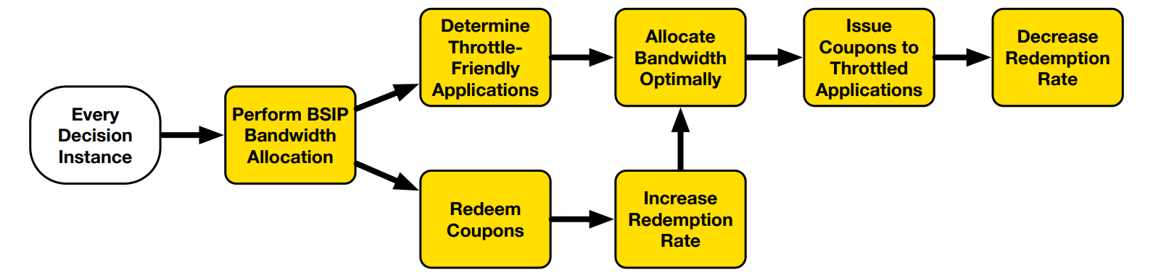
GIFT workflow:

Slide 30
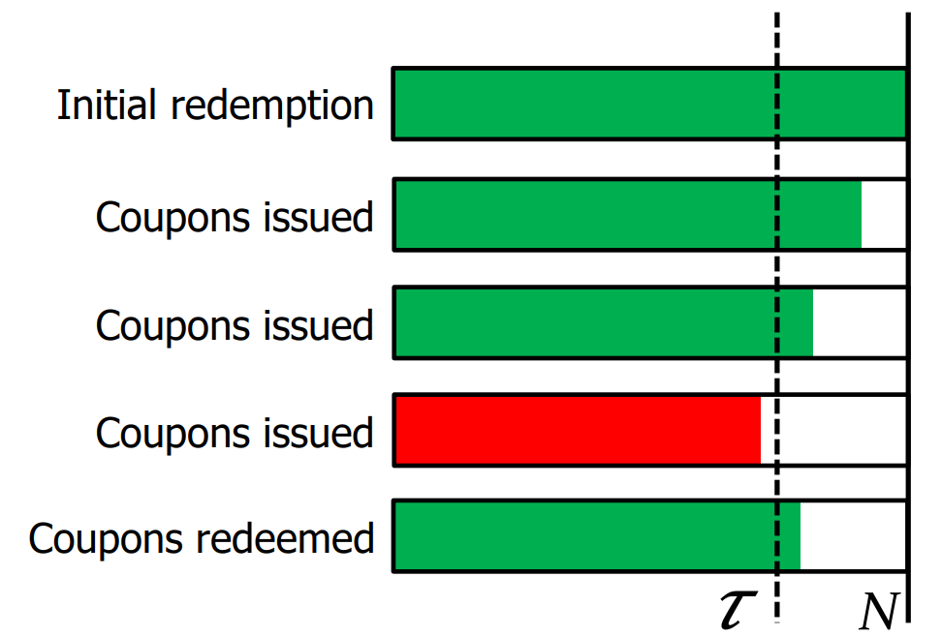
Throttling applications:
Careful design leads to minimal system regret budget (compute hours given out due to unfair treatment in long term).
Throttle-friendly apps can also be expanded if deemed beneficial.
Set of throttle-friendly applications changes over time.

Slide 31
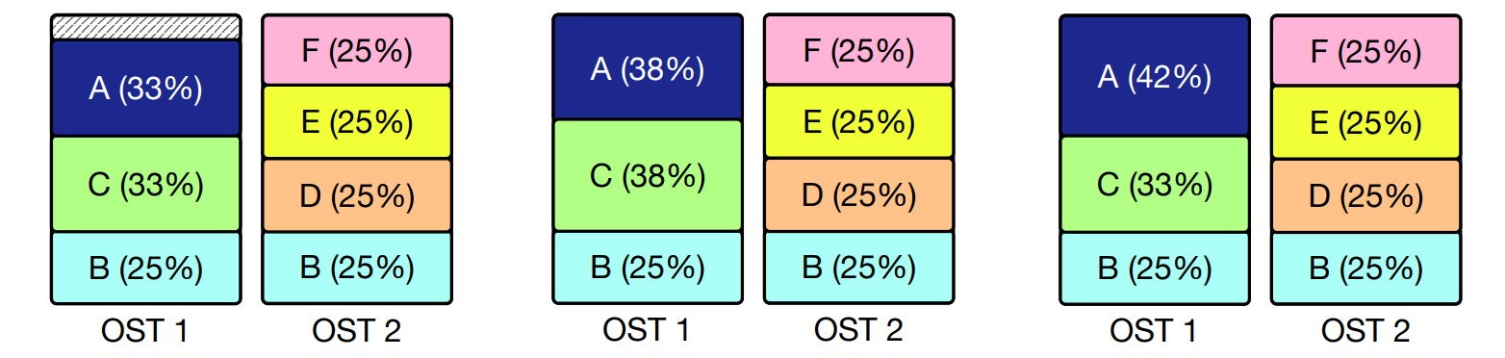
Coupon redemption:
GIFT redeems coupons only when it does not require throttling other applications:
Spare B/W available.
A has an outstanding coupon worth 15%.
Equal division possible, but GIFT does not.
Instead, GIFT (partially) redeems A’s coupon, but doesn’t throttle C.

Slide 32
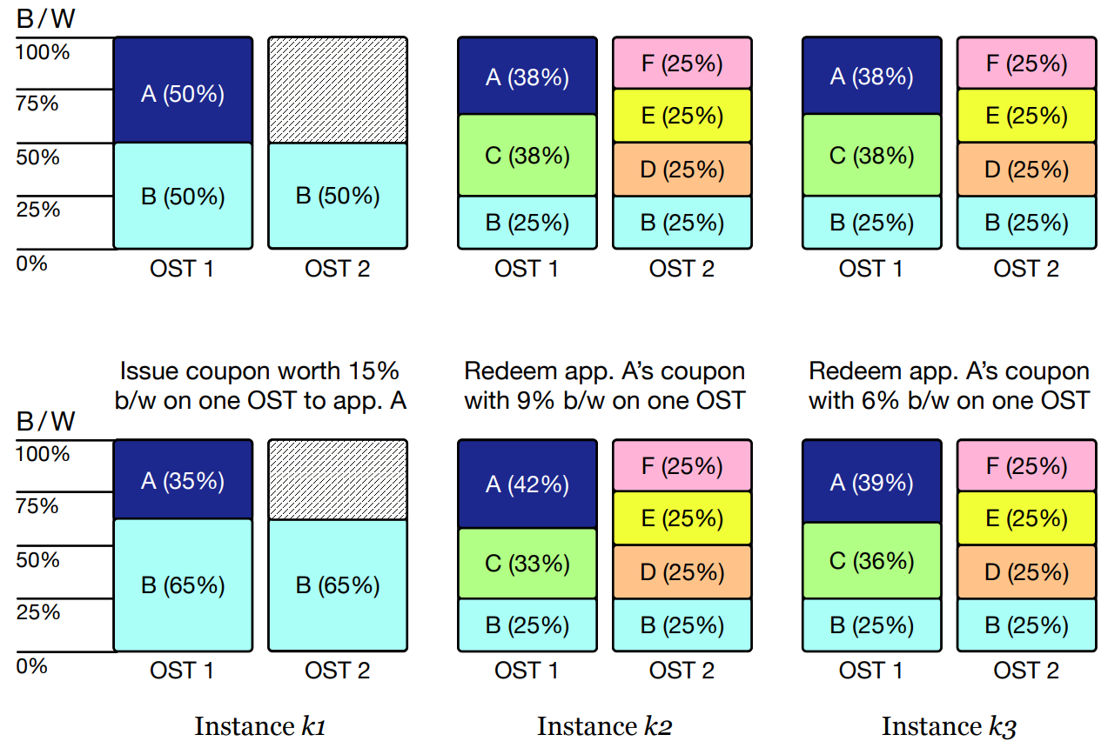
BSIP
GIFT

Slide 33
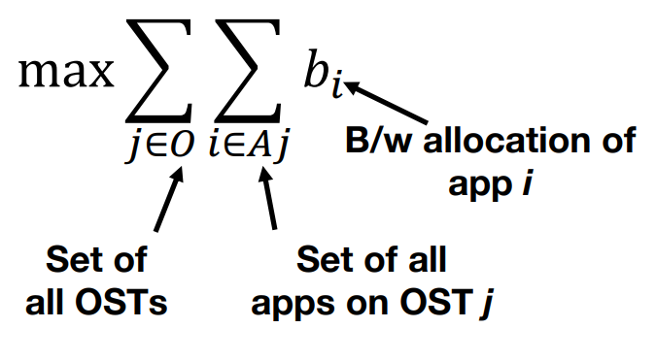
Optimal Bandwidth Allocation:
Formulated as a linear programming optimization problem, subject to some constraints:
All I/O requests of an application issued across all OSTs should get the same B/W for synch. I/O progress.
The final B/W allocation should be fair.
All OSTs are constrained by their full capacity.

Slide 34
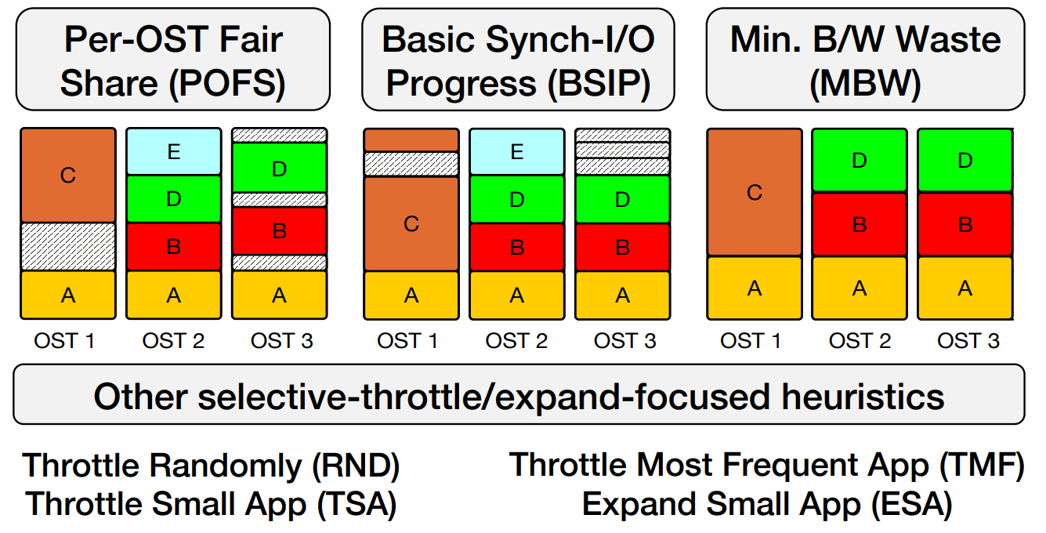
Competing strategies:

Slide 35
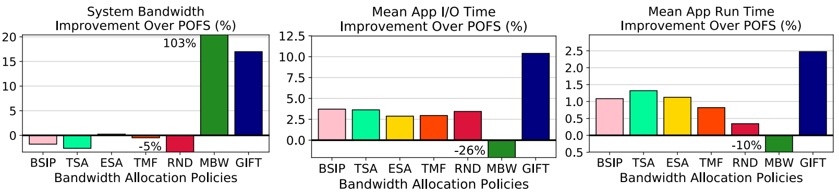
Evaluation and Analysis:
GIFT real-system prototype improves the system bandwidth my more than 15% and app I/O time by more than 10%, compared to POFS.
GIFT’s fairness is comparable to BSIP and is much fairer than MBW.
Simulation-based results (on Stampede2, MIRA and THETA supercomputers) confirm system prototype results.

Slide 36
Rio: Order-Preserving and CPU-Efficient Remote
Storage Access
Included in the Proceedings of the 2023 EuroSys

Slide 37
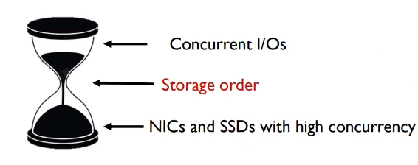
Recent Trend
Remote storage access has been increasingly popular
NVMe SSDs offer unparalleled efficiency compared to traditional storage media
Inefficient storage ordering guarantee
Almost synchronous

Slide 38
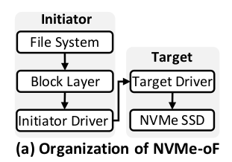
Background and Related Work
Remote Storage Access:
Two Componentes: Initiator and Target
To preserve the storage order they still rely on synchronous execution
Synchronous transfer and FLUSH command
The cost of this traditional approach is expensive
Each layer of NVMe-oF is orderless.

Slide 39
Motivation
Alleviating the overhead of storage barrier instructions
Making data transfer asynchronous
Reducing CPU cycles whenever possible

Slide 40
Rio
Makes the storage stack conceptually similar to the CPU pipeline
Introduced the I/O pipeline that allows internal out-of-order and asynchronous execution for ordered write requests while offering intact external storage order to applications
It interfaces with the block layer of the operating system, making it compatible with various file systems and storage protocols.

Slide 41
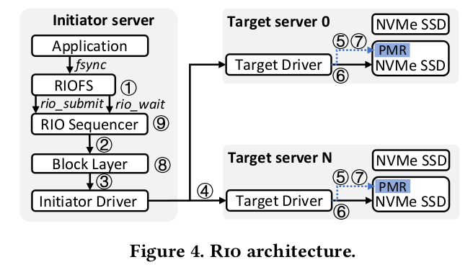
Rio Architecture
Revised Storage Stack
Rio Sequencer
Ordered Write Requests
Concurrency and Scalability
Crash Consistency

Slide 42
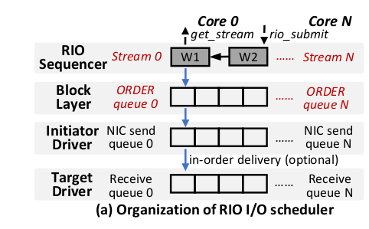
Rio Sequencer
Generates a special persitent ordering attribute which is an identity of ordered request, and then dispatches the requests to the block layer asynchronously
When finished and returned to Rio sequencer, Rio completes the requests in order using the ordering attributes

Slide 43
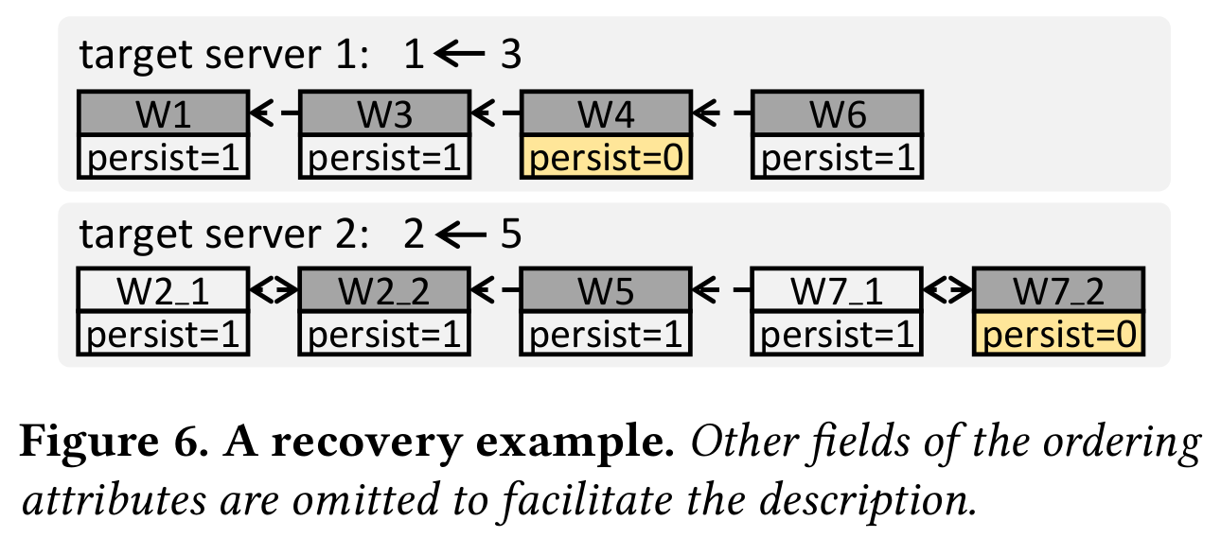
Crash Recovery
Initiator Recovery: Collects per-server ordering lists
Creates a global ordering list and send back
Target Recovery: Initiator reconnects and create the ordering list
Connects the failed server until successful

Slide 44
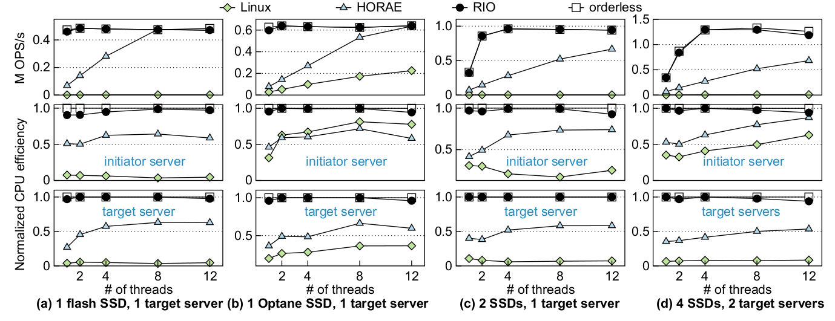
Evaluation

Slide 45
Limitations
It is primarily tailored for NVMe SSDs equipped with Persistent Memory Regions (PMR)
The system's behavior in extremely high-load scenarios or in highly scalable environments has not been thoroughly explored
Incorporating it into existing systems may present complexities.

